Slide 1

Free Python and Django workshops
for women on Oct. 10, 2015 in Pittsburgh

Slide 2
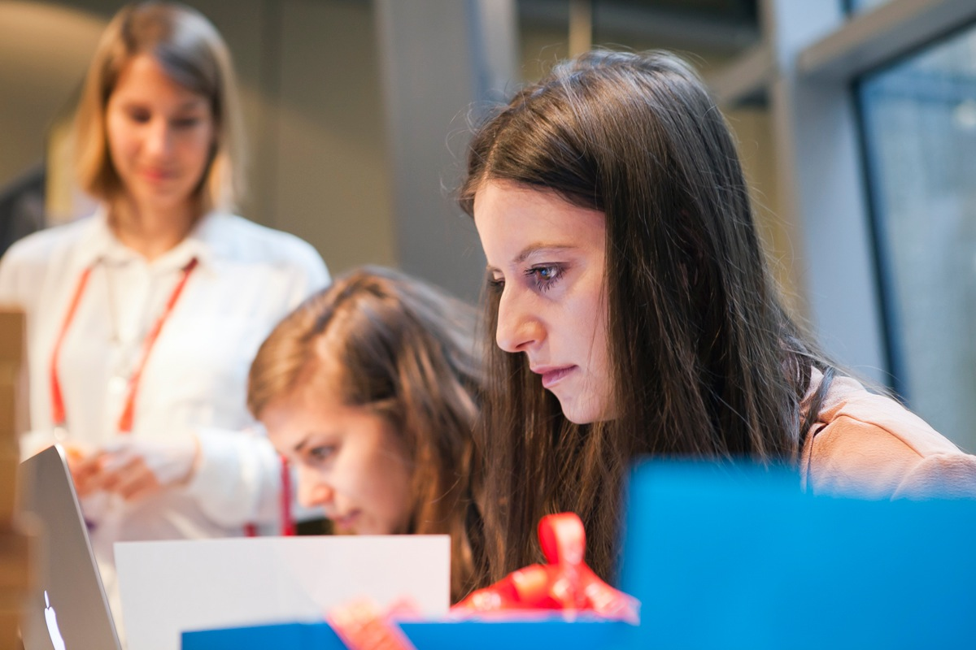
About
Oct. 10, 2015
Pittsburgh, Pennsylvania
Django Girls Pittsburgh is a free, one-day workshop for 30 people about building your first application using HTML, CSS, Python and Django. The workshop consists of two parts: installation party in the evening and a the full day of coding. Attendees work in small groups of 3 with a coach dedicated to each group. Coaches voluntarily help us in their free time.
Our goal is to bring more amazing women into the world of technology and increase diversity in the Python and Django communities. We believe that technology is for people and everyone should be able to build it. We are making technology more approachable by creating simple tools and resources designed with empathy.

Slide 3
Target
Date & place
Supporters
30 underprivileged women who never programmed before but are motivated to get into field
Full day, Oct. 10, 2015
Pittsburgh, Berlin
(We are still looking for a venue. Talk with us about hosting!)
We are seeking coaches, sponsors and other support!
Join Us!

Slide 4
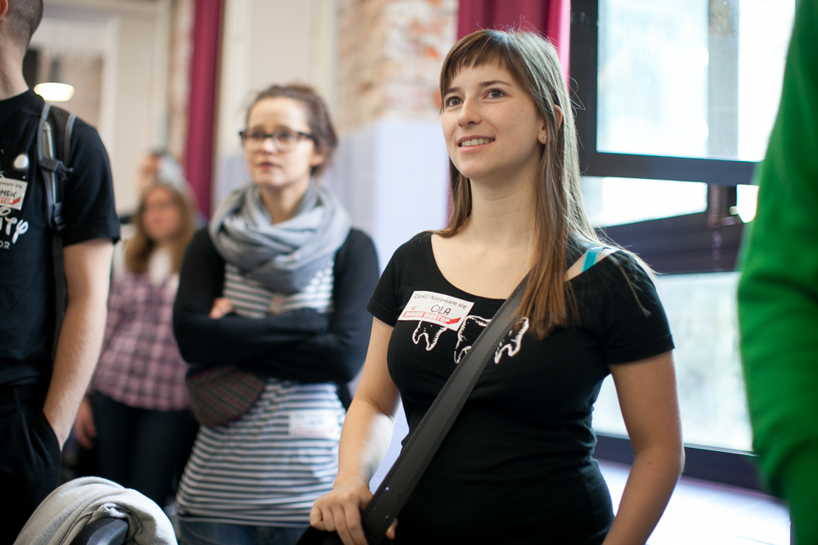
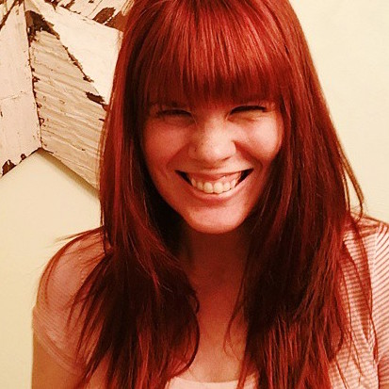
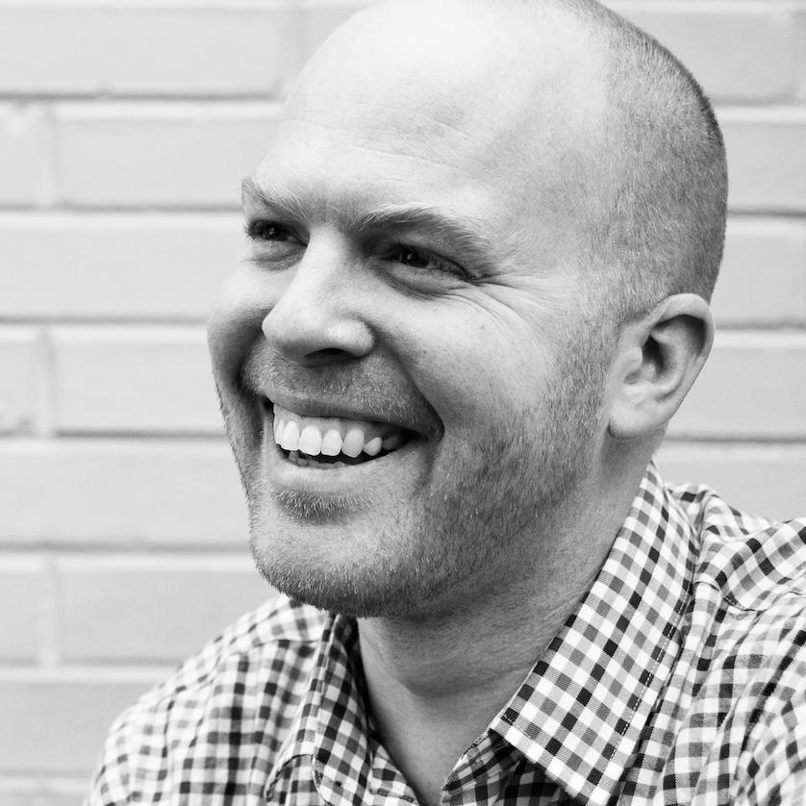
Team
Django Girls Pittsburgh is organized by Todd Waits and Jessie Hedges. Todd and Jessie both work with the Software Engineering Institute at Carnegie Mellon University and have experience with Django. They have a passion for increasing diversity and inclusion in the tech community. They have a passion for software development, and they love helping others fall in love with it, too.
Jessie Hedges
@toddwaits

Slide 5
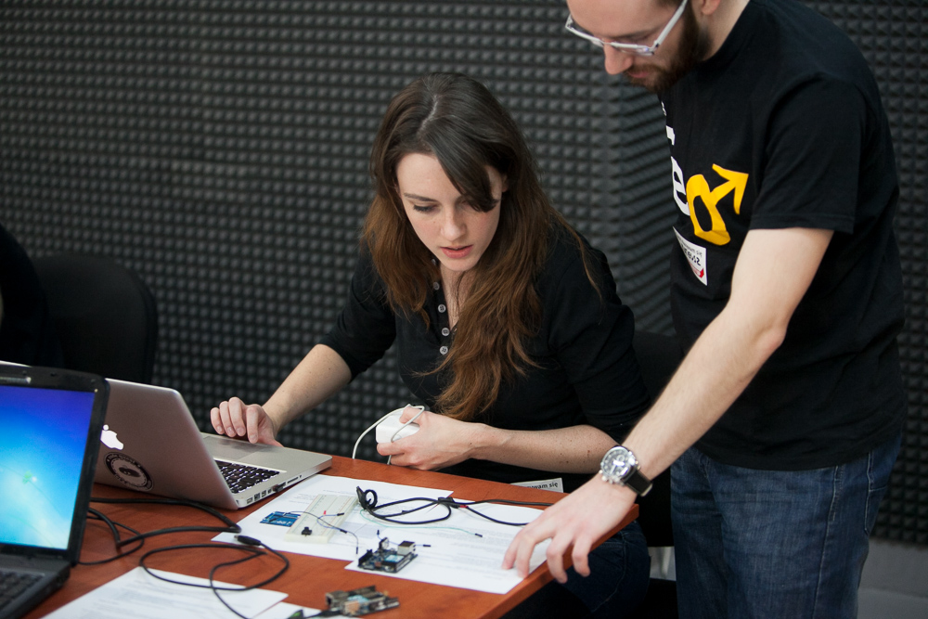
SUPPORT US!
We’re looking for people and organizations that support the goal of bringing more women into technology, to help us.
You can help us invite women from Pittsburgh to participate in Django Girls programming workshop. We need funds to cover costs of food, refreshments and workshop aids like technical books, or useful gadgets to make the first contact with coding a great experience.

Slide 6
SUPPORT US!
You can help us in three ways:
$1000
$800
$500
company logo on website
company poster at workshop
post on Twitter and Facebook
5-minute Lightning Talk
company logo on website
company poster at workshop
post on Twitter and Facebook
company logo on website
post on Twitter and Facebook

Slide 7
Thanks! ♥
Django Girls Pittsburgh
@DjangoGirlsPGH
fb.me/DjangoGirlsPgh
Get in touch:
pittsburgh@djangogirls.org

